Slide 1
Online Plant Nursery Application

Slide 2
Technologies
Java 8
Spring Boot
Spring Security
Angular | React
PostgreSQL | MYSQL
Maven | Gradle

Slide 3
Problem Statement
To Create an Application for Online Plant Nursery Application
Customer should be able to view the list of Plants , Seeds , Planters.
Customer should be able to buy order desired plants, seeds, planters .
Admin should be able to perform below operations:
1.Plants Management
2.Seeds Management
3.Planters Management
4.Customer Management

Slide 4
Plan
Design
Generate the skeleton as per class design provided
TDD approach
Identify test cases for each module
Write Failing Test cases
Convert the Test Cases in GREEN
Implement the case study in incremental manner

Slide 5
Modules
Login Module
Customer Module
Plants Management Module
Seeds Management Module
Planters
Management Module
OrderBooking Management module

Slide 6
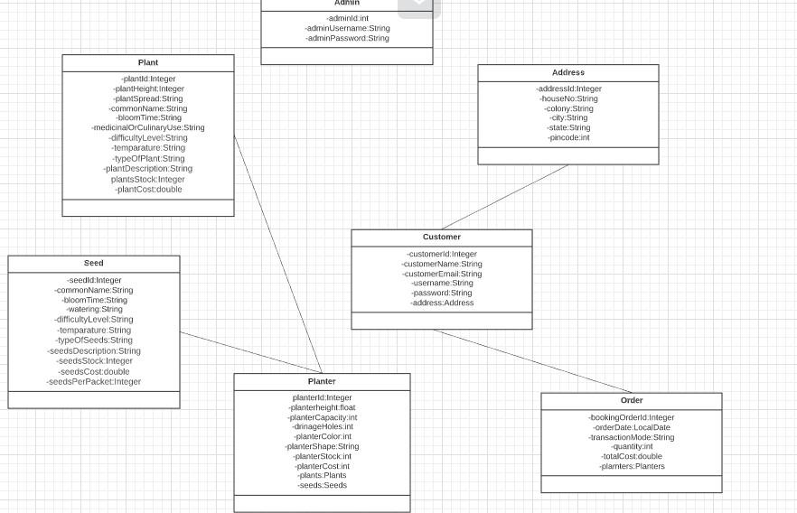
Class Design [POJO Classes]

Slide 7
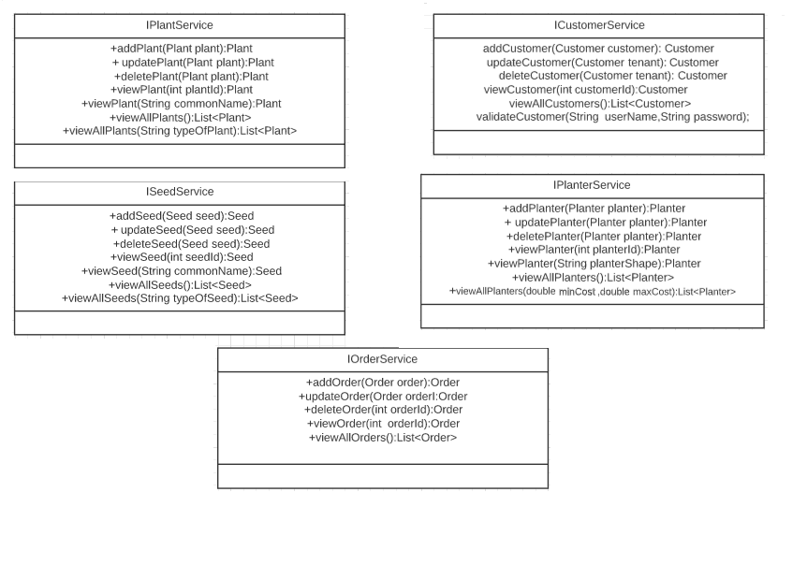
Class Design [Service Interface]

Slide 8
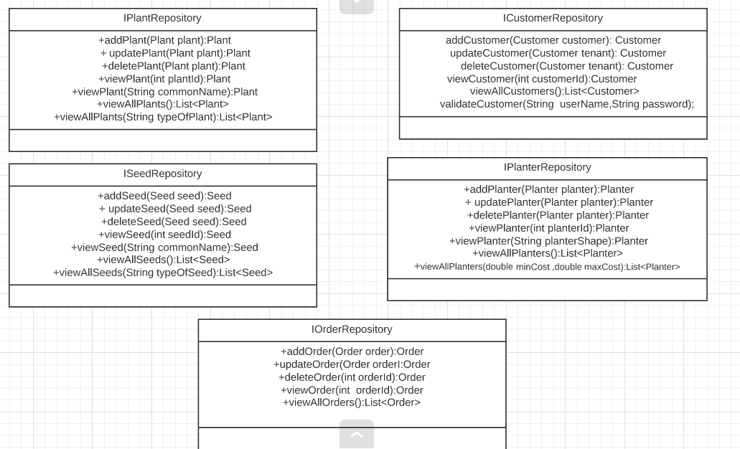
Class Design [Repository]

